Slide 1
Sistem Informasi DTA AT-Taqwa
Hindun Siti Hodijah 1137050103

Slide 2
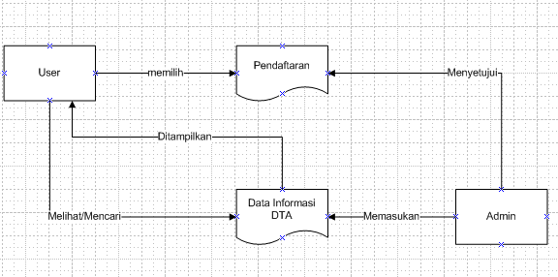

Slide 3
Use Case

Slide 4
Class Diagram

Slide 5
Sequence Diagram Home

Slide 6
Sequence Diagram Login (Admin)

Slide 9
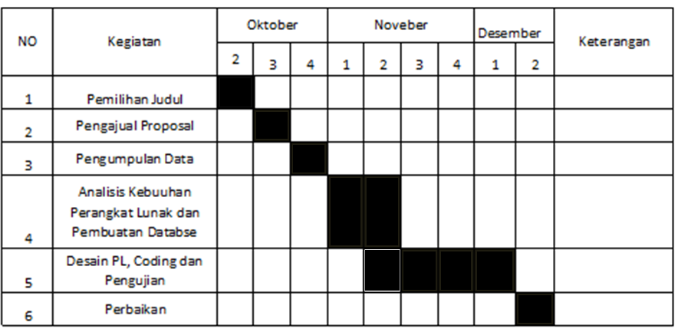
Schedule

